Slide 1
Logistic Regression

Slide 2
Logistic regression
The linear regression model assumes that the response variable Y is quantitative. But in many situations, the response variable is instead qualitative
Predicting a qualitative response for an observation can be referred to as classifying that observation, since it involves assigning the observation to a category, or class.
The methods used for classification first predict the probability of each of the categories of a qualitative variable, as the basis for making the classification. In this sense they also behave like regression methods.

Slide 3
Logistic regression
Binomial (or binary) logistic regression is applied when the dependent variable is dichotomous – that is, has only two different possible values.
A set of predictors is identified which assesses the most likely of the two nominal categ­ories a particular case falls into.
The predictor variables may be any type of variable – quantitative or qualitative
Dichotomous Dependent Variable – Binary Logistic Regression
More than two categories – Multinomial Logistic Regression

Slide 4
Typical Applications
What variables affect voting preference? Researchers want to predict how a person will vote (two options) based on demographic characteristics of the individual.
Is this customer a good candidate for a loan? A bank wants to predict whether a customer will default on a loan based on known demographic and financial information.
Will this patient develop coronary heart disease? In a longitudinal study of 450 patients, the independent variables age, gender, smoking behavior, and blood pressure are used to predict whether patients will develop coronary heart disease during the study.

Slide 5
Uses of Logistic Regression
To predict the probability of an event occurring based on a list of one or more predictor variables
To rank the relative importance of predictor variables in explaining the response variable
To calculate an odds ratio that measures the importance of a predictor variable on the response

Slide 6
Maximum Likelihood Estimator
The equations in logistic regression are not of a form such that Ordinary Least Squares estimation can be used. Instead, we use an estimator called maximum likelihood.
Maximum likelihood estimation works iteratively – it has a guess at what the parameter estimates are, and then calculates a measure of how well the parameter estimates fit the data - This measure is called the log likelihood function, and the larger it is the better the model fits the data.
The parameter estimates are then tweaked a little, and the log likelihood function is re-estimated. If it shows an improvement, the estimates are kept, but if it shows deterioration, the estimates are discarded and the model is tweaked a different way. When the model cannot be improved by tweaking in any way, it is said to have converged.

Slide 7


Multiple Regression
Logistic Regression
E(Y) = p =the probability that the dependent variable is equal to 1
B₀ is the equation intercept (or constant), and
B_{1,} B_{2,} B₃ etc are the coefficients for the predictor variable.
Think of these coefficients in a similar way as those in multiple regression. -, the parameters B₀ and B₁ are estimated from the data, and a statistical test is used to determine whether the coefficient B₁ can be considered to be non-zero.

Slide 8
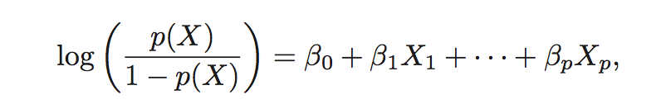
The logistic regression model relates the log of the odds to the explanatory variable(s)
The left-hand side is called the log-odds or logit. We see that the logistic regression model has a logit that is linear in X.
In a linear regression model, β₁ gives the average change in Y associated with a one-unit increase in X.
In a logistic regression model, increasing X by one unit changes the log odds by β₁, or equivalently it multiplies the odds by e^{β1}

Slide 9

Odds & Odds Ratio
The odds in favour of an event occurring is defined as the probability the event will occur divided by the probability the event will not occur.
Odds = p / (1-p)
The odds ratio is the odds that Y = 1 given that one of the independent variables has been increased by one unit (odds₁) divided by the odds that Y = 1 given no change in the values for the independent variables (odds₀).

Slide 10
The odds ratio: exp(B)
Odds ratio: the change in odds of being in one of the categories of outcome when the value of a predictor increases by one unit.
Indicates the change in odds resulting from a unit change in the predictor.
OR > 1: Predictor ↑, Probability of outcome occurring ↑.
OR < 1: Predictor ↑, Probability of outcome occurring ↓.

Slide 11
Assumptions
Dependent Variable outcomes should be mutually exclusive
Sample size
Logistic regression works best with large samples – perhaps 20 cases per predictor (min 60 cases total)
Small samples with a large number of predictors can be problematic.
Absence of Multicollinearity
Ideally predictor variables will be strongly related to the dependent variable but not strongly related to each other.
Outliers
Identify outlying cases by inspecting the residuals

Slide 12
Coding of Responses
Assign Value of 0 to whichever response indicates the lack or absence of the characteristic of interest. e.g. 0 = absence of disease, absence of sale
Same for categorical independent variables
For continuous independent variables high values should indicate more of the characteristic of interest

Slide 13
Assessing Predictors: The Wald Statistic
Similar to t-statistic in Regression.
The Wald Statistic tests the null hypothesis that b = 0.
This statistic is based on the ratio between the B-weight and the standard error. The significance values of the Wald statistic indicate which of our predictors is statistically significant.

Slide 14
Example – warranty.sav

Slide 15
Example
The sales director of a chain of appliance stores wants to find out what circumstances encourage customers to purchase extended warranties after a major appliance purchase. The response variable is an indicator of whether or not a warranty is purchased. The predictor variables they want to consider are the following:
Age of the customer
Whether a gift is offered with the warranty
Price of the appliance (price100 is the price divided by 100)
Data file: Warranty.sav

Slide 16
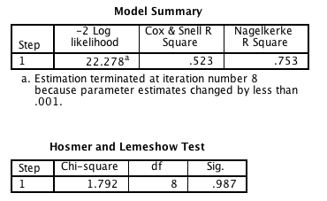
Cox & Snell and Nagelkerke R square
The Cox & Snell R square of 0.523 and Nagelkerke R square of 0.753 are analagous to the R² measure in multiple regression.
These may be described as pseudo r-square statistics.
They refer to the amount of variation in the dependent variable which is predicted by the predictor variables collectively. The maximum value of this, in theory, is 1.00 if the relationship is perfect; it will be 0.00 if there is no relationship. They are pseudo-statistics because they appear to be like r-square but they are only actually analogous to it.

Slide 17
Hosmer & Lemshow Test
The Hosmer & Lemshow Test is another test of model fit. – poor fit is indicated by sig < 0.05. Sig. of 0.987 indicates support for the model
Another way to assess the model is to use the information in the Model Summary table In general, when comparing models, the lower the –2*(log likelihood) (–2LL) value, the better the fit.

Slide 18
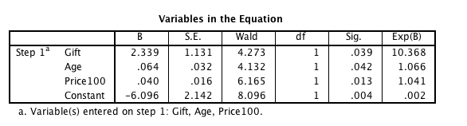
The key output is in the ‘Variables in the equation’ table.
The p values (sig) for all the variables suggest that they contribute significantly to the predictive ability of the model.
The Wald value is the test statistic
Similar to t-statistic in Regression.
Tests the null hypothesis that b = 0.
The B values are the equivalent to β values in multiple regression – sign tells the direction of influence for each variable.

Slide 19
The values in the column headed Exp(B) are the odds ratios for each variable in the equation. - the change in odds of being in one of the categories of outcome when the value of a predictor increases by one unit
The results show that the odds that a customer who is offered a gift will purchase a warranty is 10 times greater than the corresponding odds for a customer having the same other characteristics but who is not offered a gift.

Slide 20
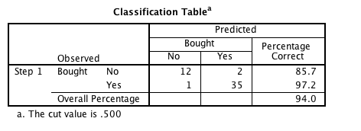
In the classification table the PAC of 94.0 (Percentage accuracy in classification) indicates that the model correctly classified 94% of cases overall

Slide 21
Example – sleep.sav

Slide 22
Example (sleep.sav)
What factors predict the likelihood that respondents would report that they had a problem with their sleep?
Outcome Variable (Categorical):
Sleep problem (1) No sleep problem (0).
Predictors:
Age
Sex
Problem getting to sleep
Problem staying asleep
Hours sleep each night etc

Slide 23
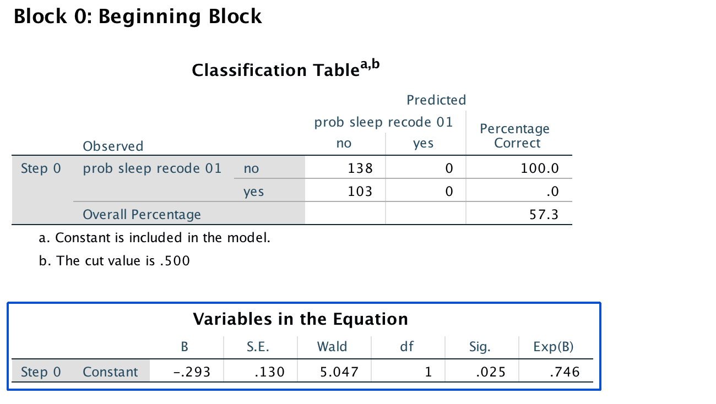
Block 0 – A Baseline Model

Slide 24
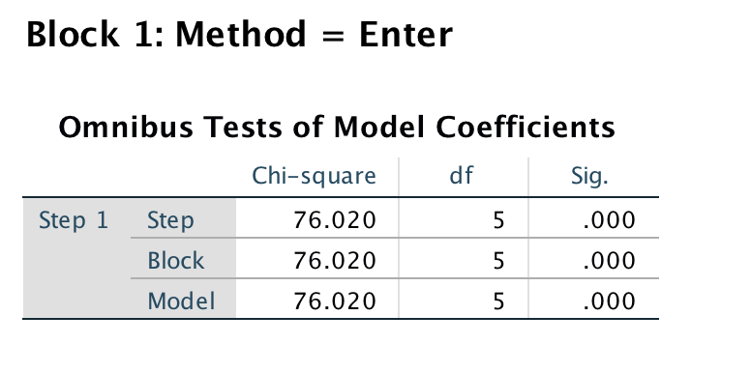
The Omnibus Test
Gives an overall indication of how well the model performs, over and above Block 0

Slide 25
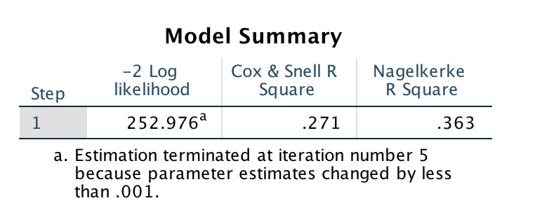
Cox & Snell and Nagelkerke R square
The Cox & Snell R square and Nagelkerke R square are analagous to the R² measure in multiple regression.
These may be described as pseudo r-square statistics. They refer to the amount of variation in the dependent variable which is predicted by the predictor variables collectively. The maximum value of this, in theory, is 1.00 if the relationship is perfect; it will be 0.00 if there is no relationship. They are pseudo-statistics because they appear to be like r-square but they are only actually analogous to it.

Slide 26
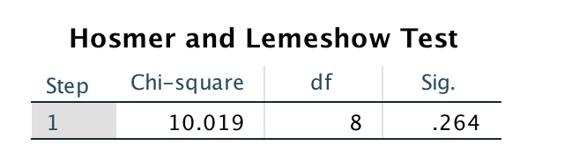
Hosmer & Lemshow Test
The Hosmer & Lemshow Test is another test of model fit. – poor fit is indicated by sig<0.05. Sig. of 0.987 indicates support for the model
Another way to assess the model is to use the information in the Model Summary table In general, when comparing models, the lower the –2*(log likelihood) (–2LL) value, the better the fit.

Slide 27
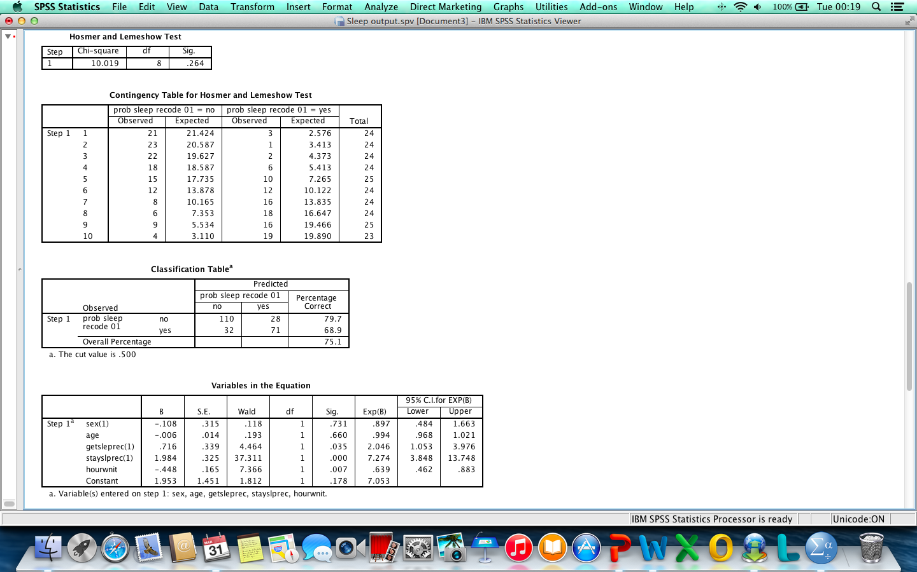
‘Variables in the equation’ table.
The key output is in the ‘Variables in the equation’ table.
The p values (sig) for all the variables indicate whether they contribute significantly to the predictive ability of the model.
The Wald value is the test statistic
Similar to t-statistic in Regression.
Tests the null hypothesis that b = 0.
The B values are the equivalent to β values in multiple regression – sign tells the direction of influence for each variable.

Slide 28
Odds Ratio Exp(B)
The values in the column headed Exp(B) are the odds ratios for each variable in the equation. - the change in odds of being in one of the categories of outcome when the value of a predictor increases by one unit
Odds of a person answering yes (sleep problem) is 7.27 times higher for someone who reports having problems staying asleep than for a person who does not have difficulty staying asleep (all other factors being equal)

Slide 29
Odds Ratios
OddsRatio > 1: Predictor ↑, Probability of outcome occurring ↑.
OddsRatio < 1: Predictor ↑, Probability of outcome occurring ↓.

Slide 30
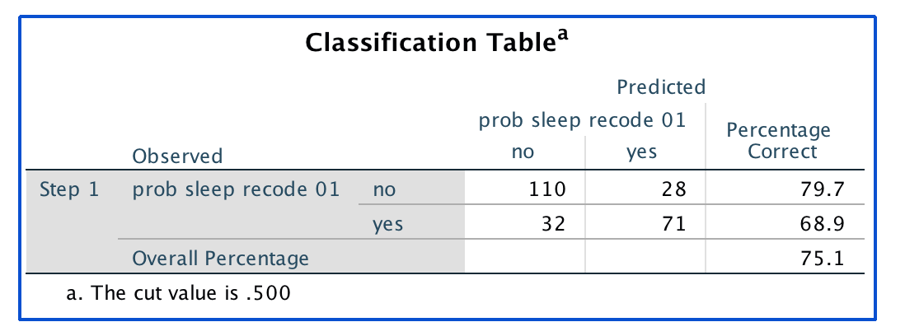
Percentage accuracy in classification
In the classification table the PAC of 75.1 (Percentage accuracy in classification) indicates that the model correctly classified 75.1% of cases overall

Slide 31
Methods of Regression
Forced Entry: All variables entered simultaneously.
Hierarchical: Variables entered in blocks.
Blocks should be based on past research, or theory being tested.
Stepwise: Variables entered on the basis of statistical criteria (i.e. relative contribution to predicting outcome).

Slide 32
Assessing the model
Overall fit of the final model – examine the omnibus tests of model coefficients
Check the table labelled Variables in the equation to see the regression parameters for any predictors in the model.
Look at the Wald statistic and its significance.
Use the odds ratio, Exp(B), for interpretation.
OR > 1, then as the predictor increases, the odds of the outcome occurring increase.
OR < 1, then as the predictor increases, the odds of the outcome occurring decrease.
The confidence interval of Exp(B) should not cross 1.

Slide 33
Model building and Parsimony
When building a model we should strive for parsimony.
predictors should not be included unless they have explanatory benefit.
First fit the model that includes all potential predictors, and then systematically remove any that don’t seem to contribute to the model.

Slide 34
Logistic Regression

